Slide 1


Project 2 : Prediction model on anime rating score Koh Si Ting

Slide 2

Motivation to predict anime rating score

Slide 3
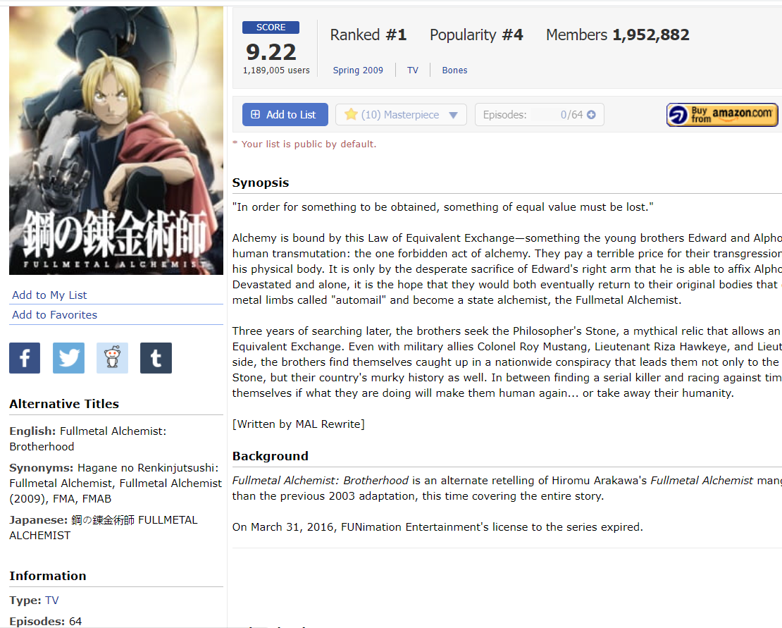
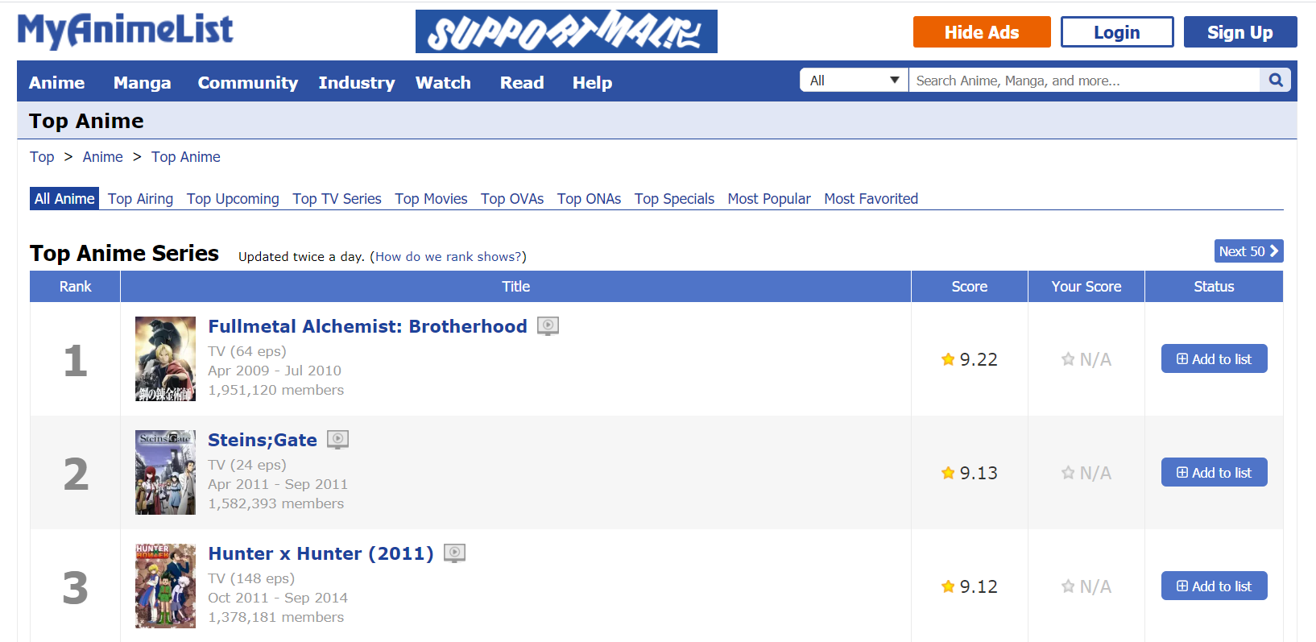
Background

Slide 4

Tools
- Beautifulsoup : Web-scraping
- Pandas : Dataframes
- Numpy : Transforming data
- Sklearn : Ridge/LASSO/ElasticNet
- Statsmodels : OLS for stats summary
- Matplotlib & Seaborn : Plot graphs

Slide 5
Methodology
Webscrape & Clean Data
Feature Engineering & Selection
Train & Evaluate Model (Model Selection)

Slide 6
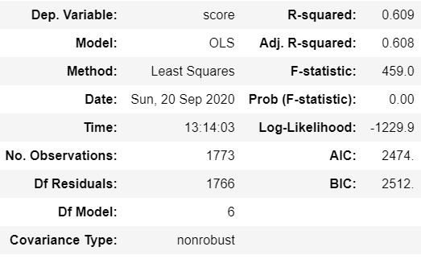
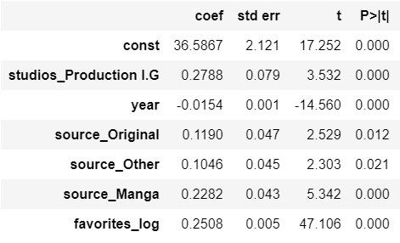
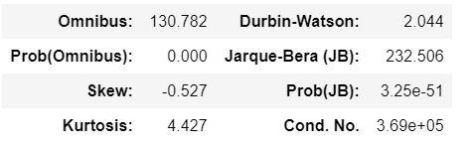
Ols Regression result

Slide 7
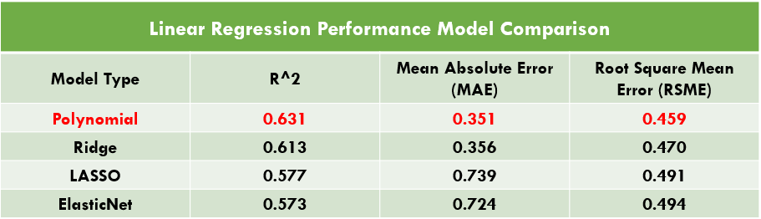
Model comparison

Slide 8
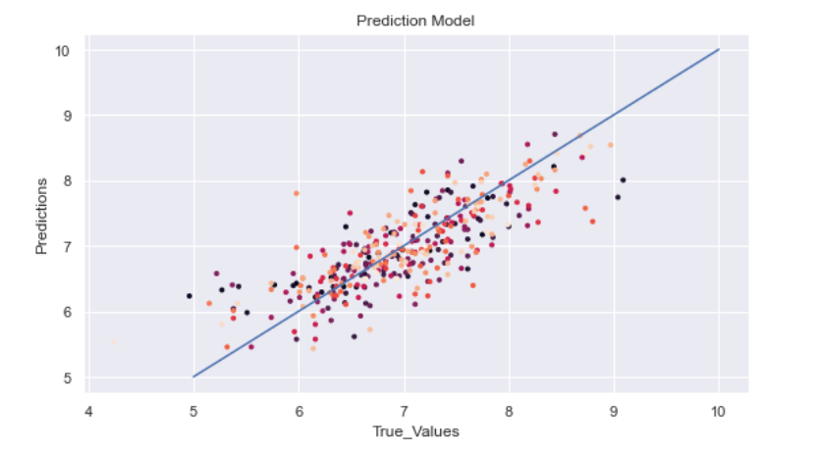
Model performance

Slide 9
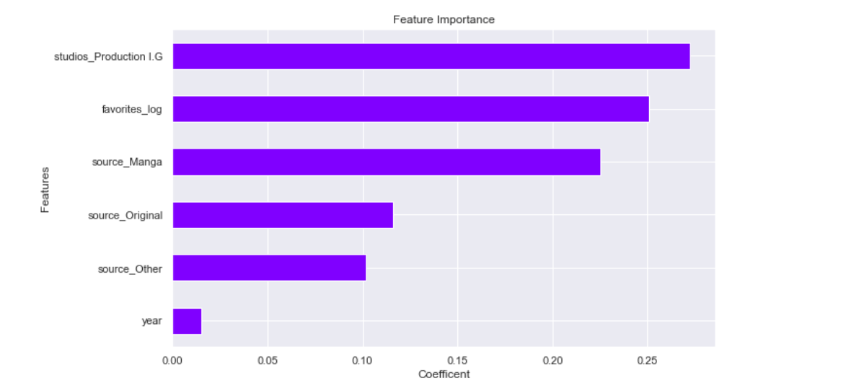
Feature importance

Slide 10

Conclusion
Good predictors for Anime Scores:
Animation by I.G Production
Added as Favorite
Storyline from Manga

Slide 11
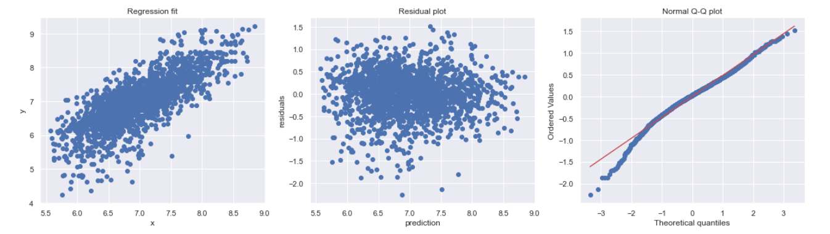
Insight
- Not the best prediction model for anime rating scores
- MAL scores are calculated from a non-linear formula
- To explore on utilizing a non-linear regression model

Slide 12

Any questions?

